Slide 1

Solar Power Plant design

Slide 2
Relay Co-ordination (part-1)

Slide 3
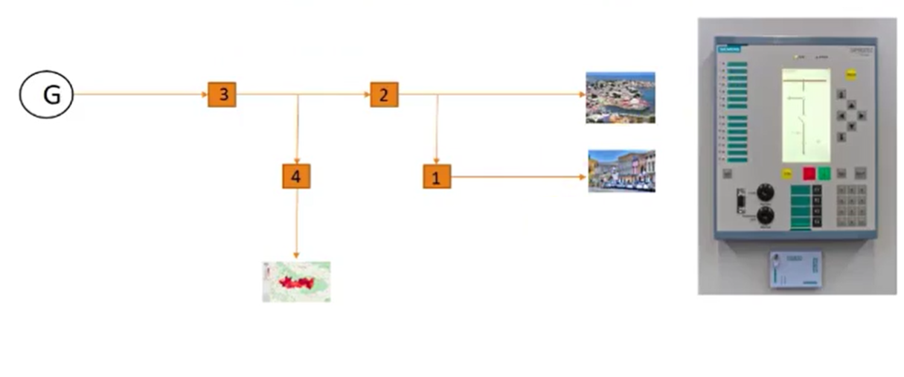
Importance of relay Co - Ordination
3
2
Operating Time
1
Distance

Slide 4
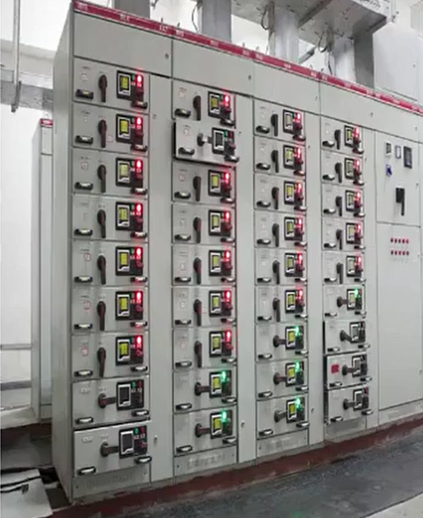
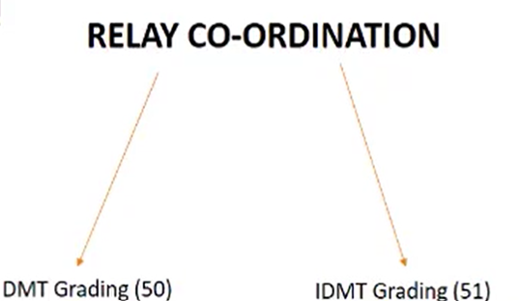
Relay Co-Ordination

Slide 5
DMT Grading – (50)
3
RELAY SETTING
50-1 Pickup : 180%
50-1 Delay : 1 Sec
50-2 Pickup : 400%
50-2 Delay : 0.1 Sec
2
Operating Time
1
Distance

Slide 6
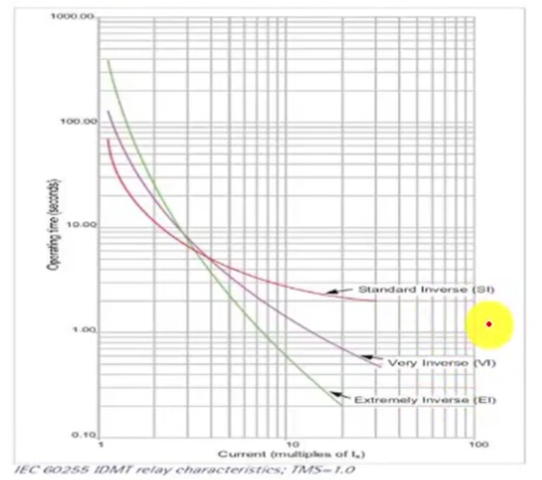
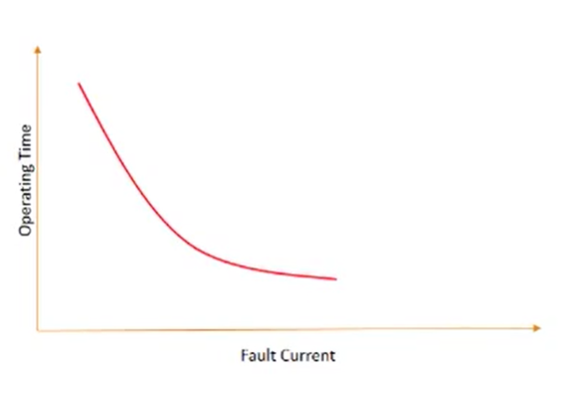
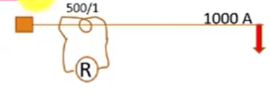

Slide 7


1. Pickup & Current Setting
Current Setting=Pickup current/CT ratio
= 600/500
= 1.2
2.Plug setting Multiplier
PSM = Fault Current / pickup Current
=1000/600
=1.67
3.TMS & Relay Operation Time
$$t=\frac{0.14×TMS}{PSM^{0.02}−1}$$
$$0⋅5=\frac{0.14×TMS}{1⋅{67}^{0.02}−1}$$

Slide 8
What would be the
operating time if we
select a curve other than
SI?
For example : Extremely
Inverse or very inverse

Slide 9
Thank you

